Slide 1
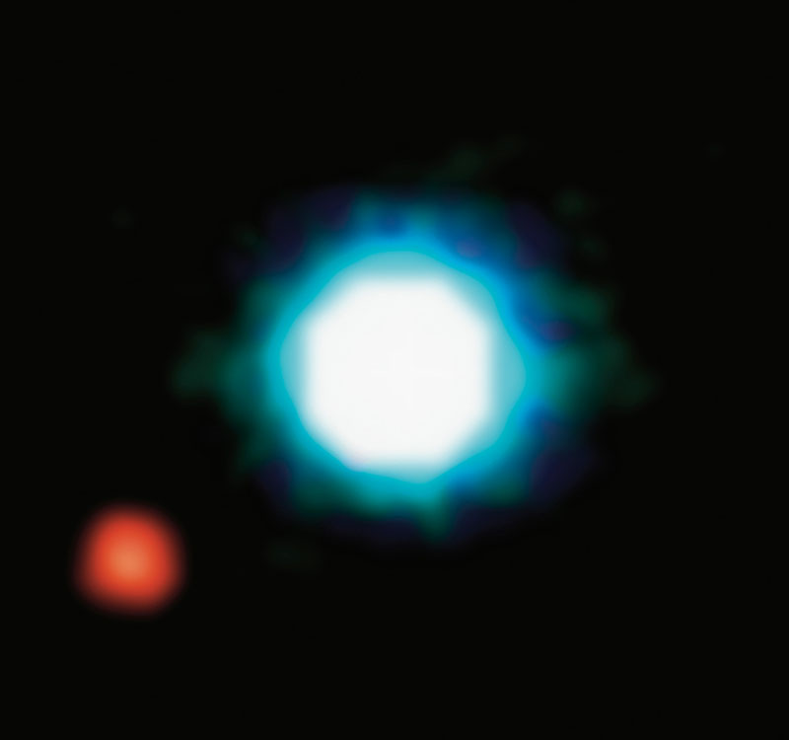
EXOPLANETS
Shall we start packing?
© NASA

Slide 2
First image of an exoplanet
2004
2M1207
Brown dwarf
230 light-years from Earth
2M1207b
Jupiter-like planet
5x Jupiter’s size
Orbits at a distance 55 larger than the Earth to the Sun
© NASA

Slide 3
To work on: We know there are planets outside of our planetary system Is there any planet habitable?

Slide 4
To work on: What would make life possible?
Earth-size planet orbiting a sun-size star
Temperature
Water
Atmosphere
Data: discovered exoplanets -> NASA

Slide 5
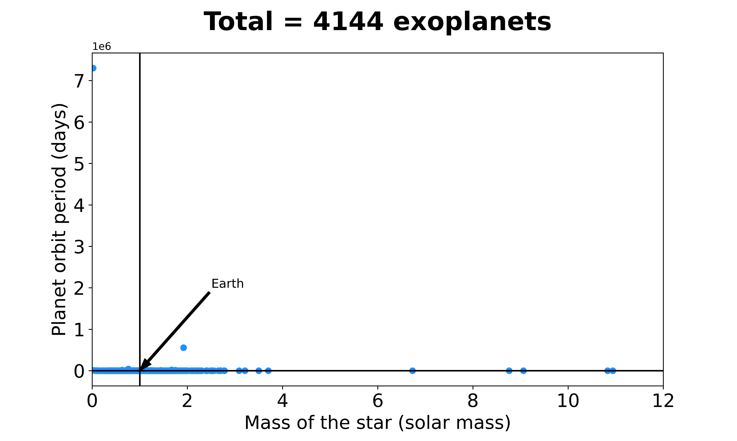
All planets discovered outside of our solar system
NOTE: THIS MIGHT STAY OUT

Slide 6
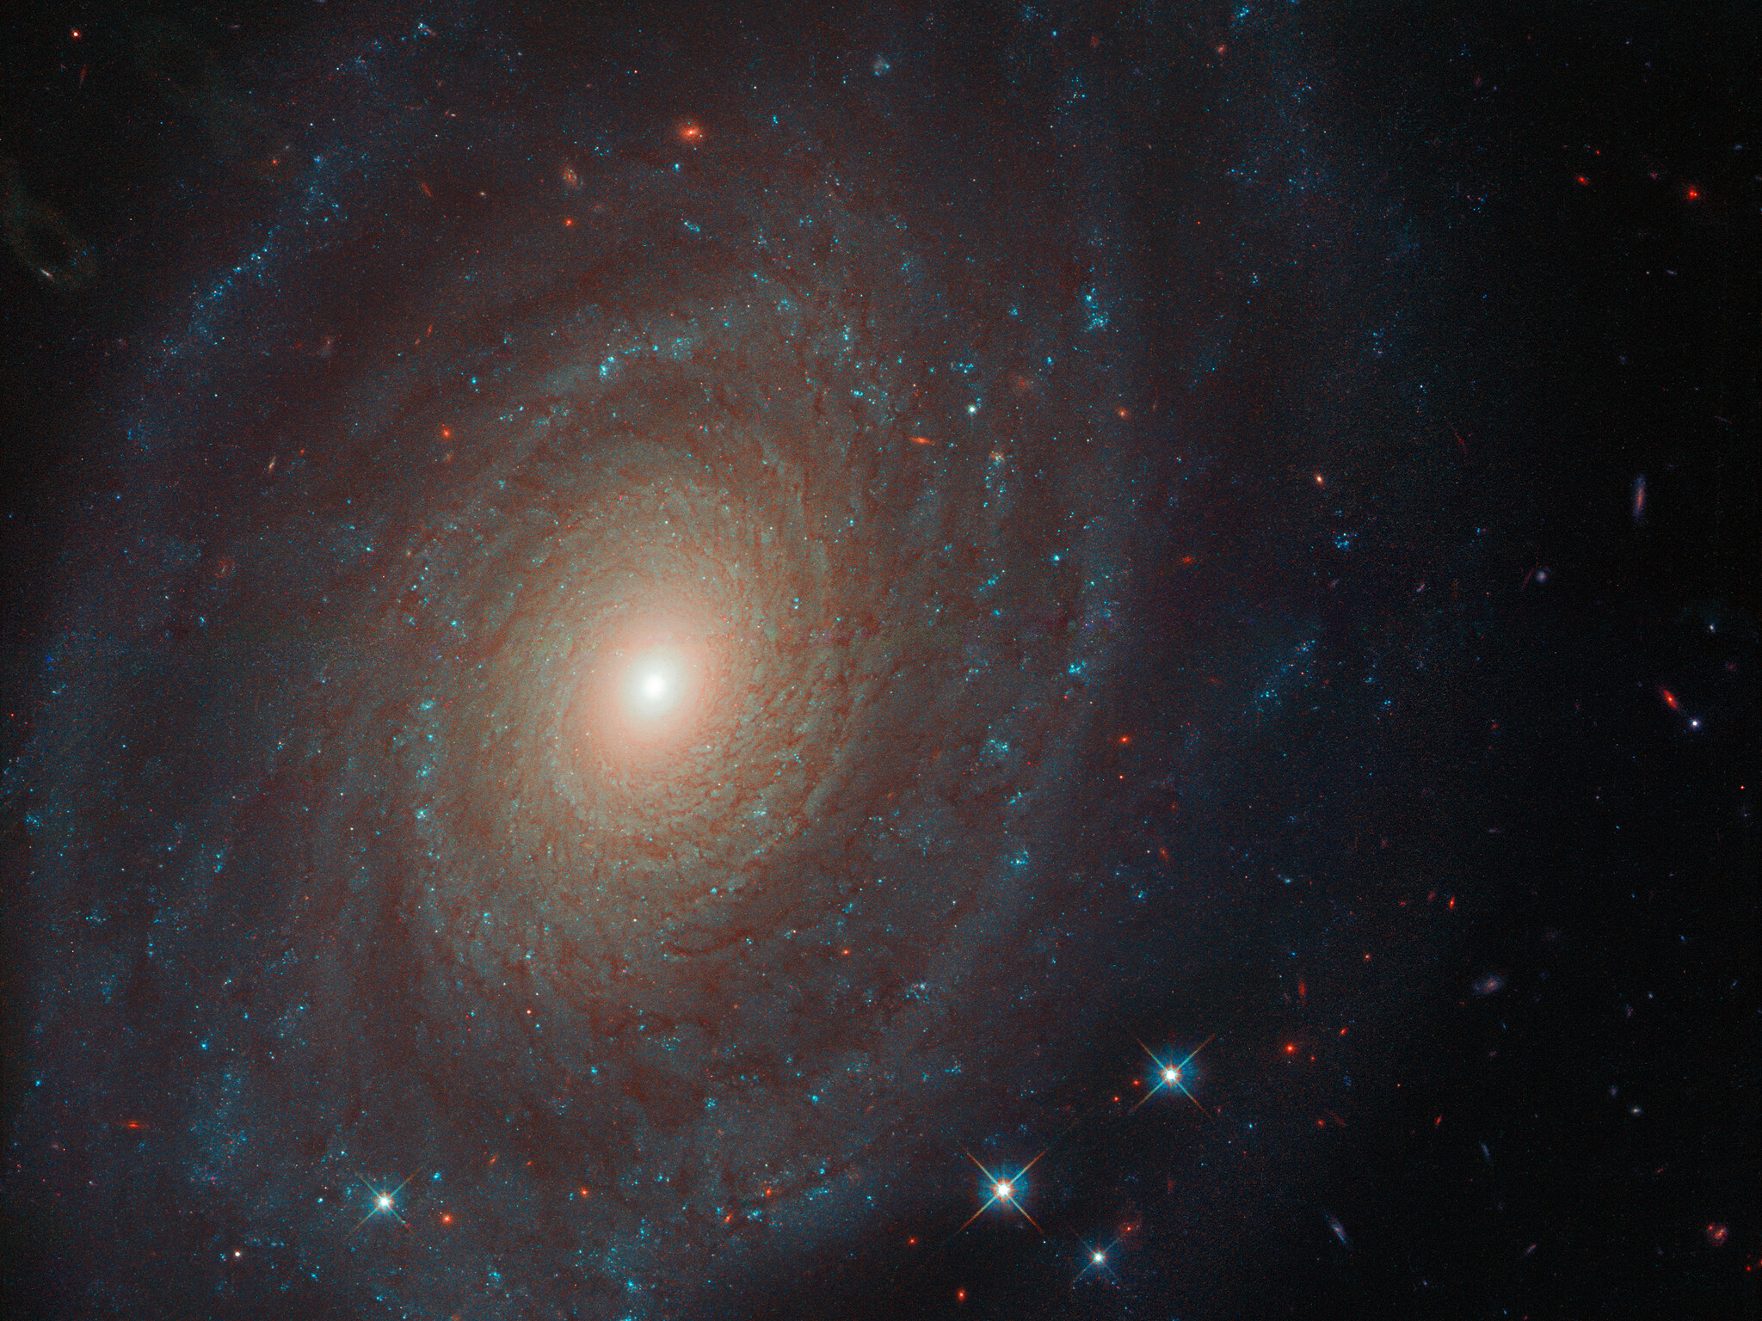
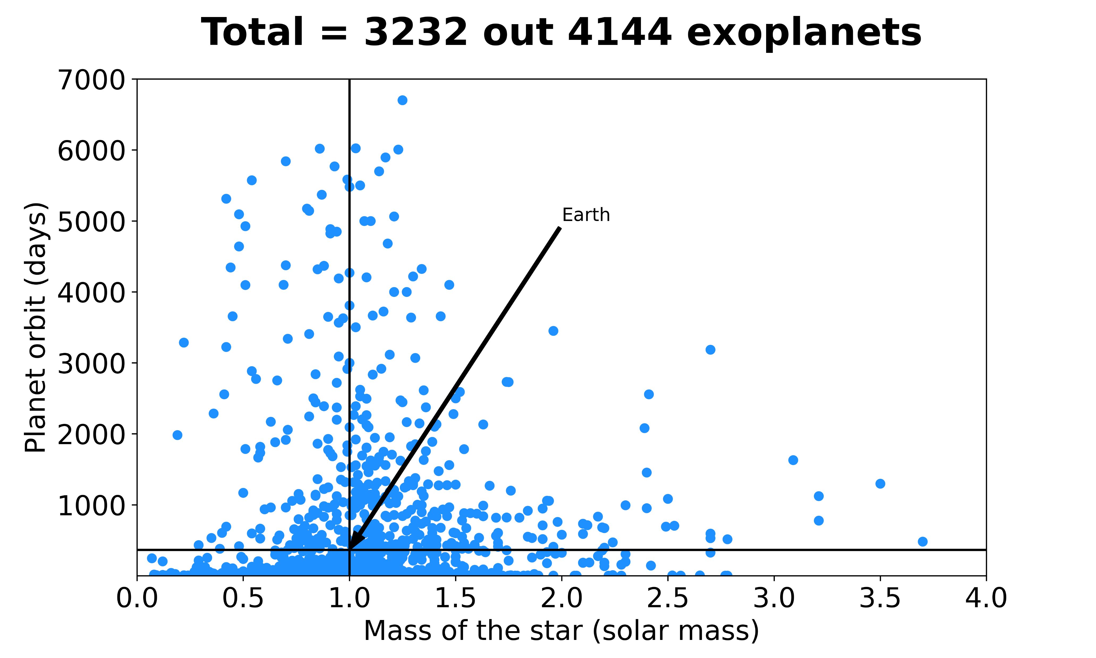
Before booking, you better check the offer…

Slide 7
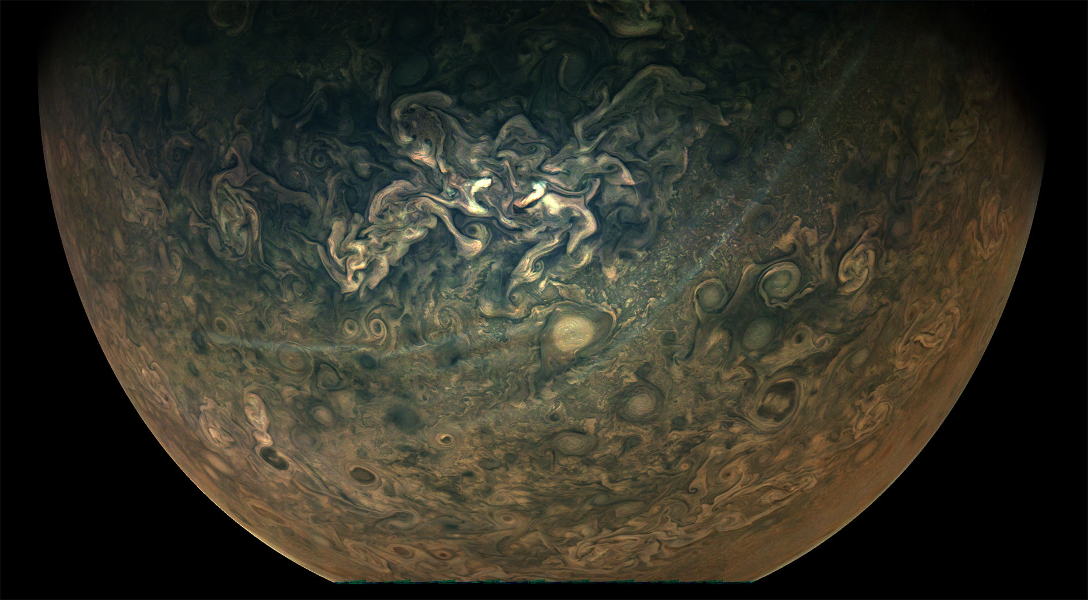
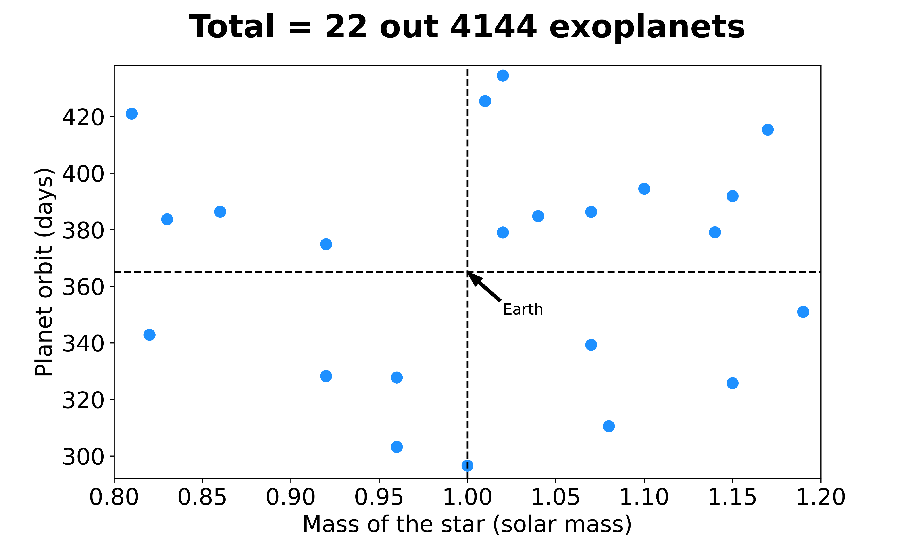
Seem like home!

Slide 8
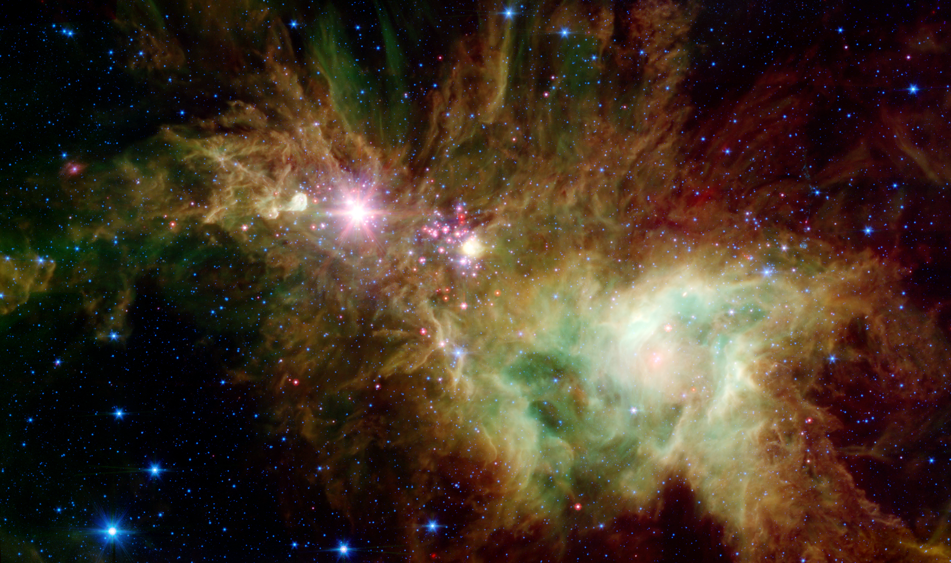
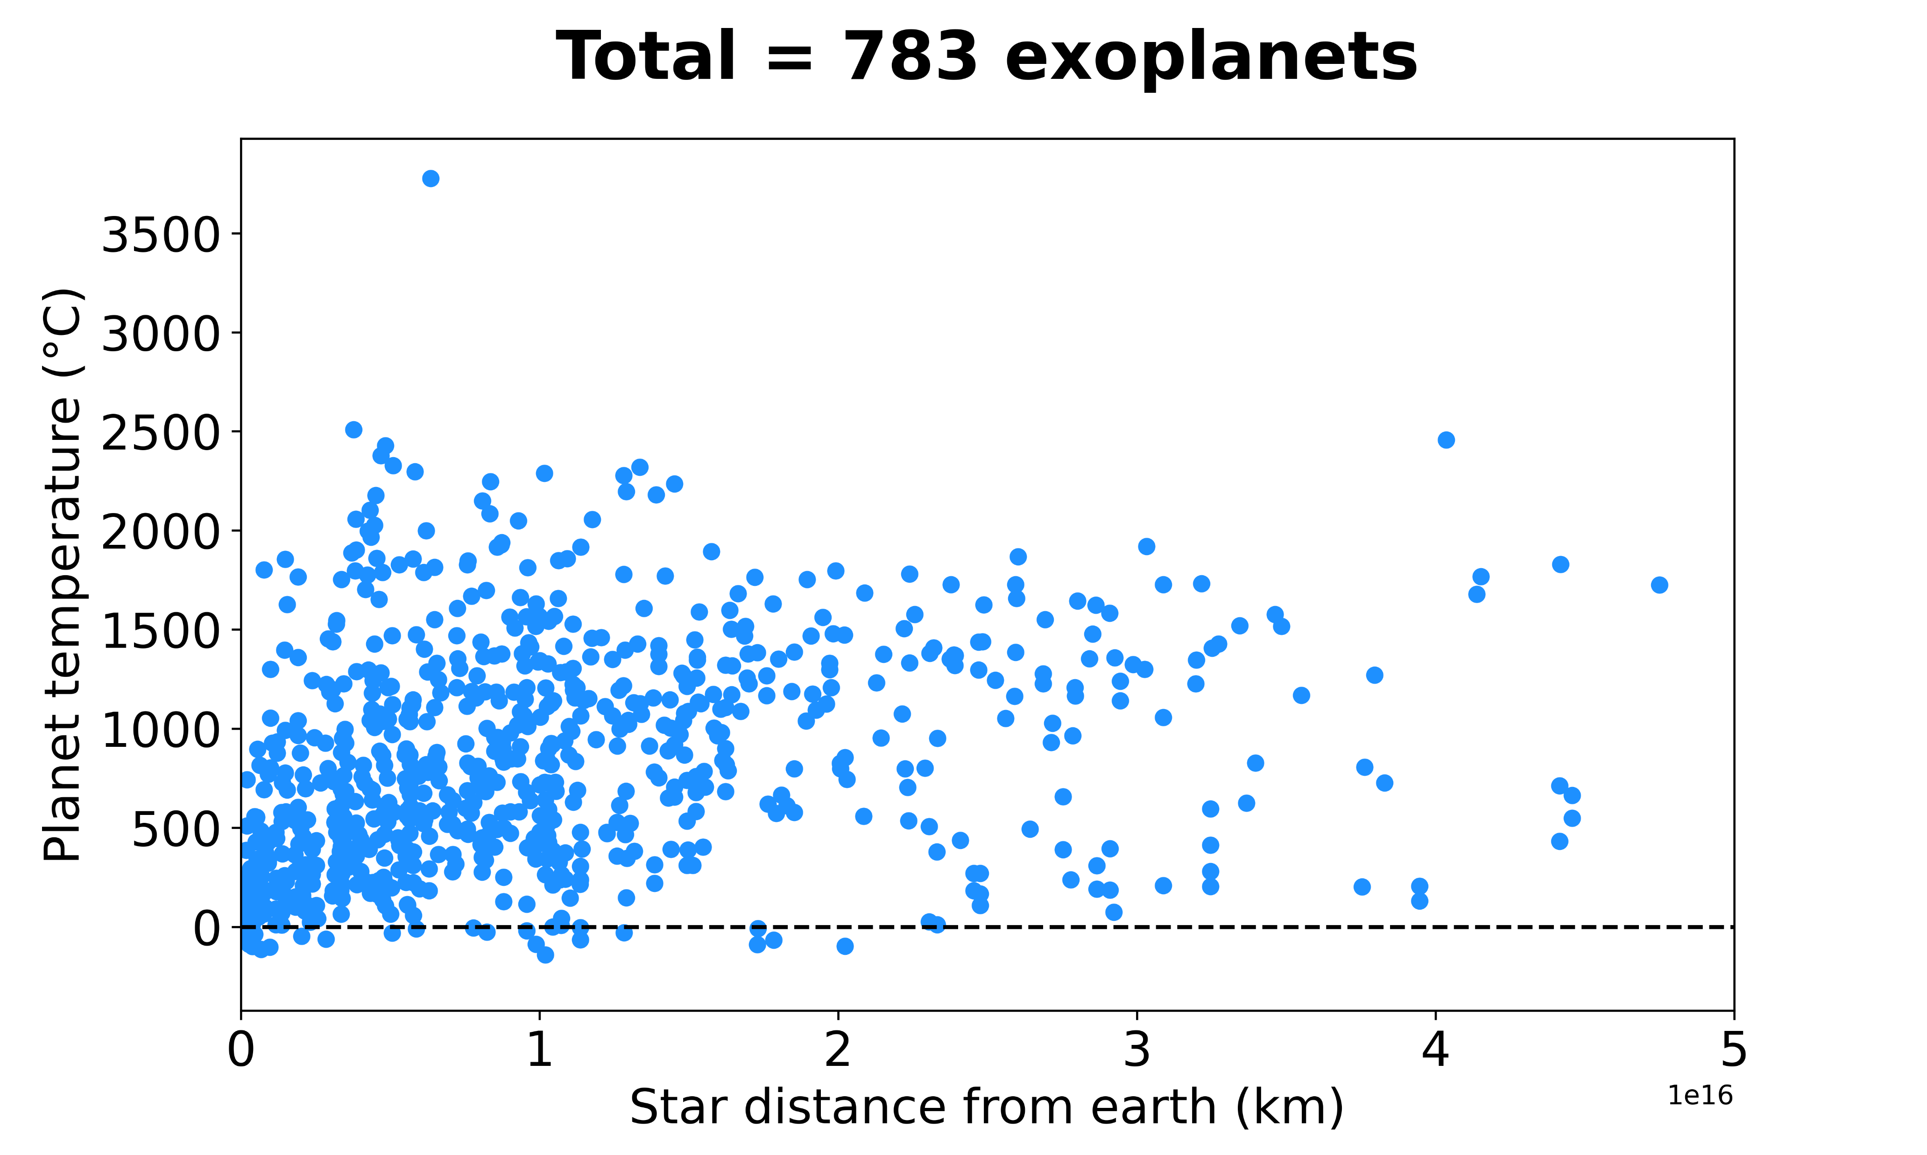
Tropical summer or cold winter?

Slide 9
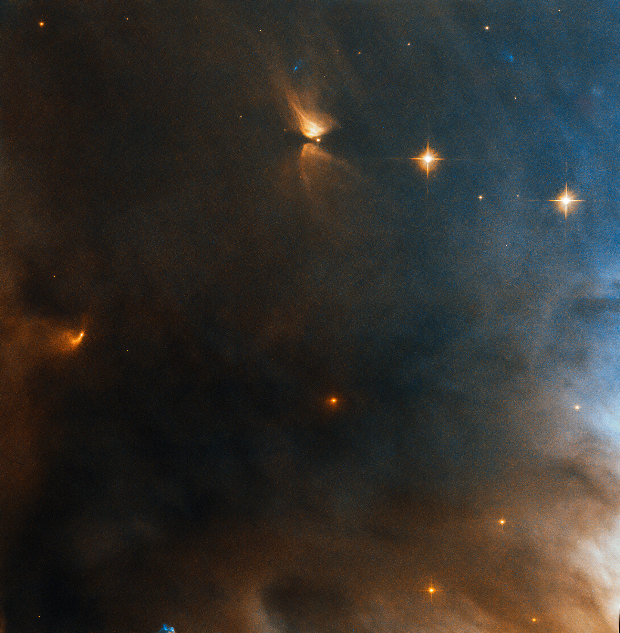
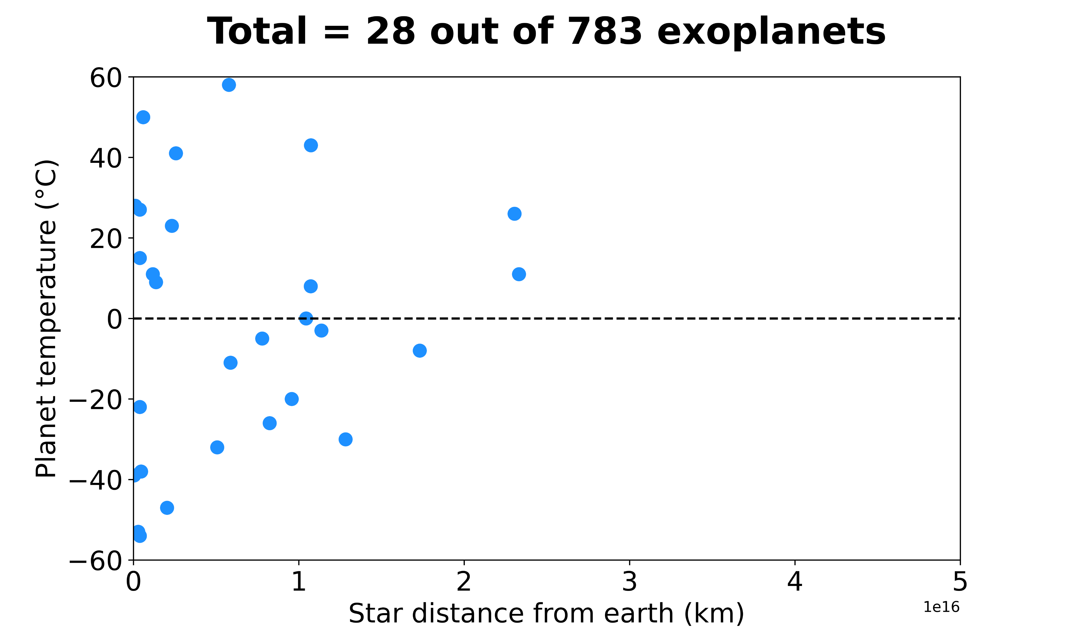
Getting cozier…

Slide 10
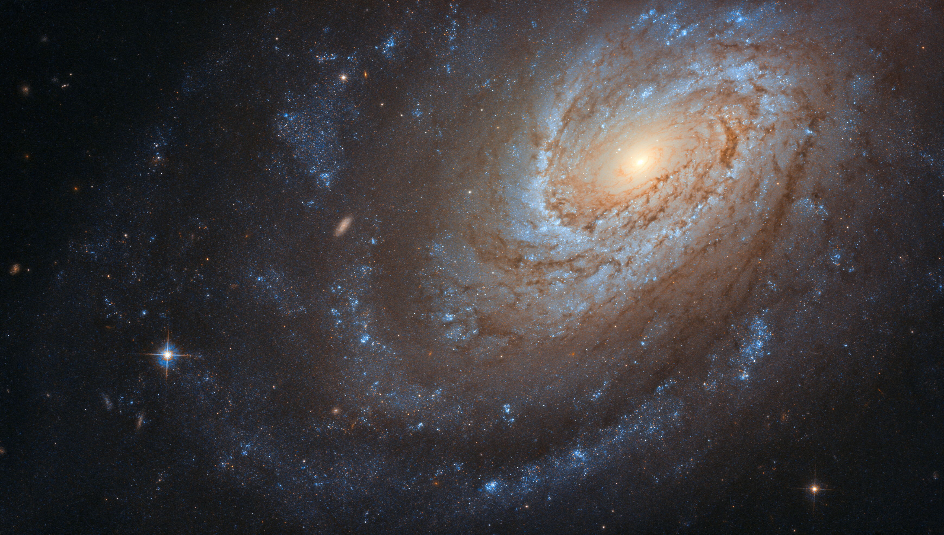
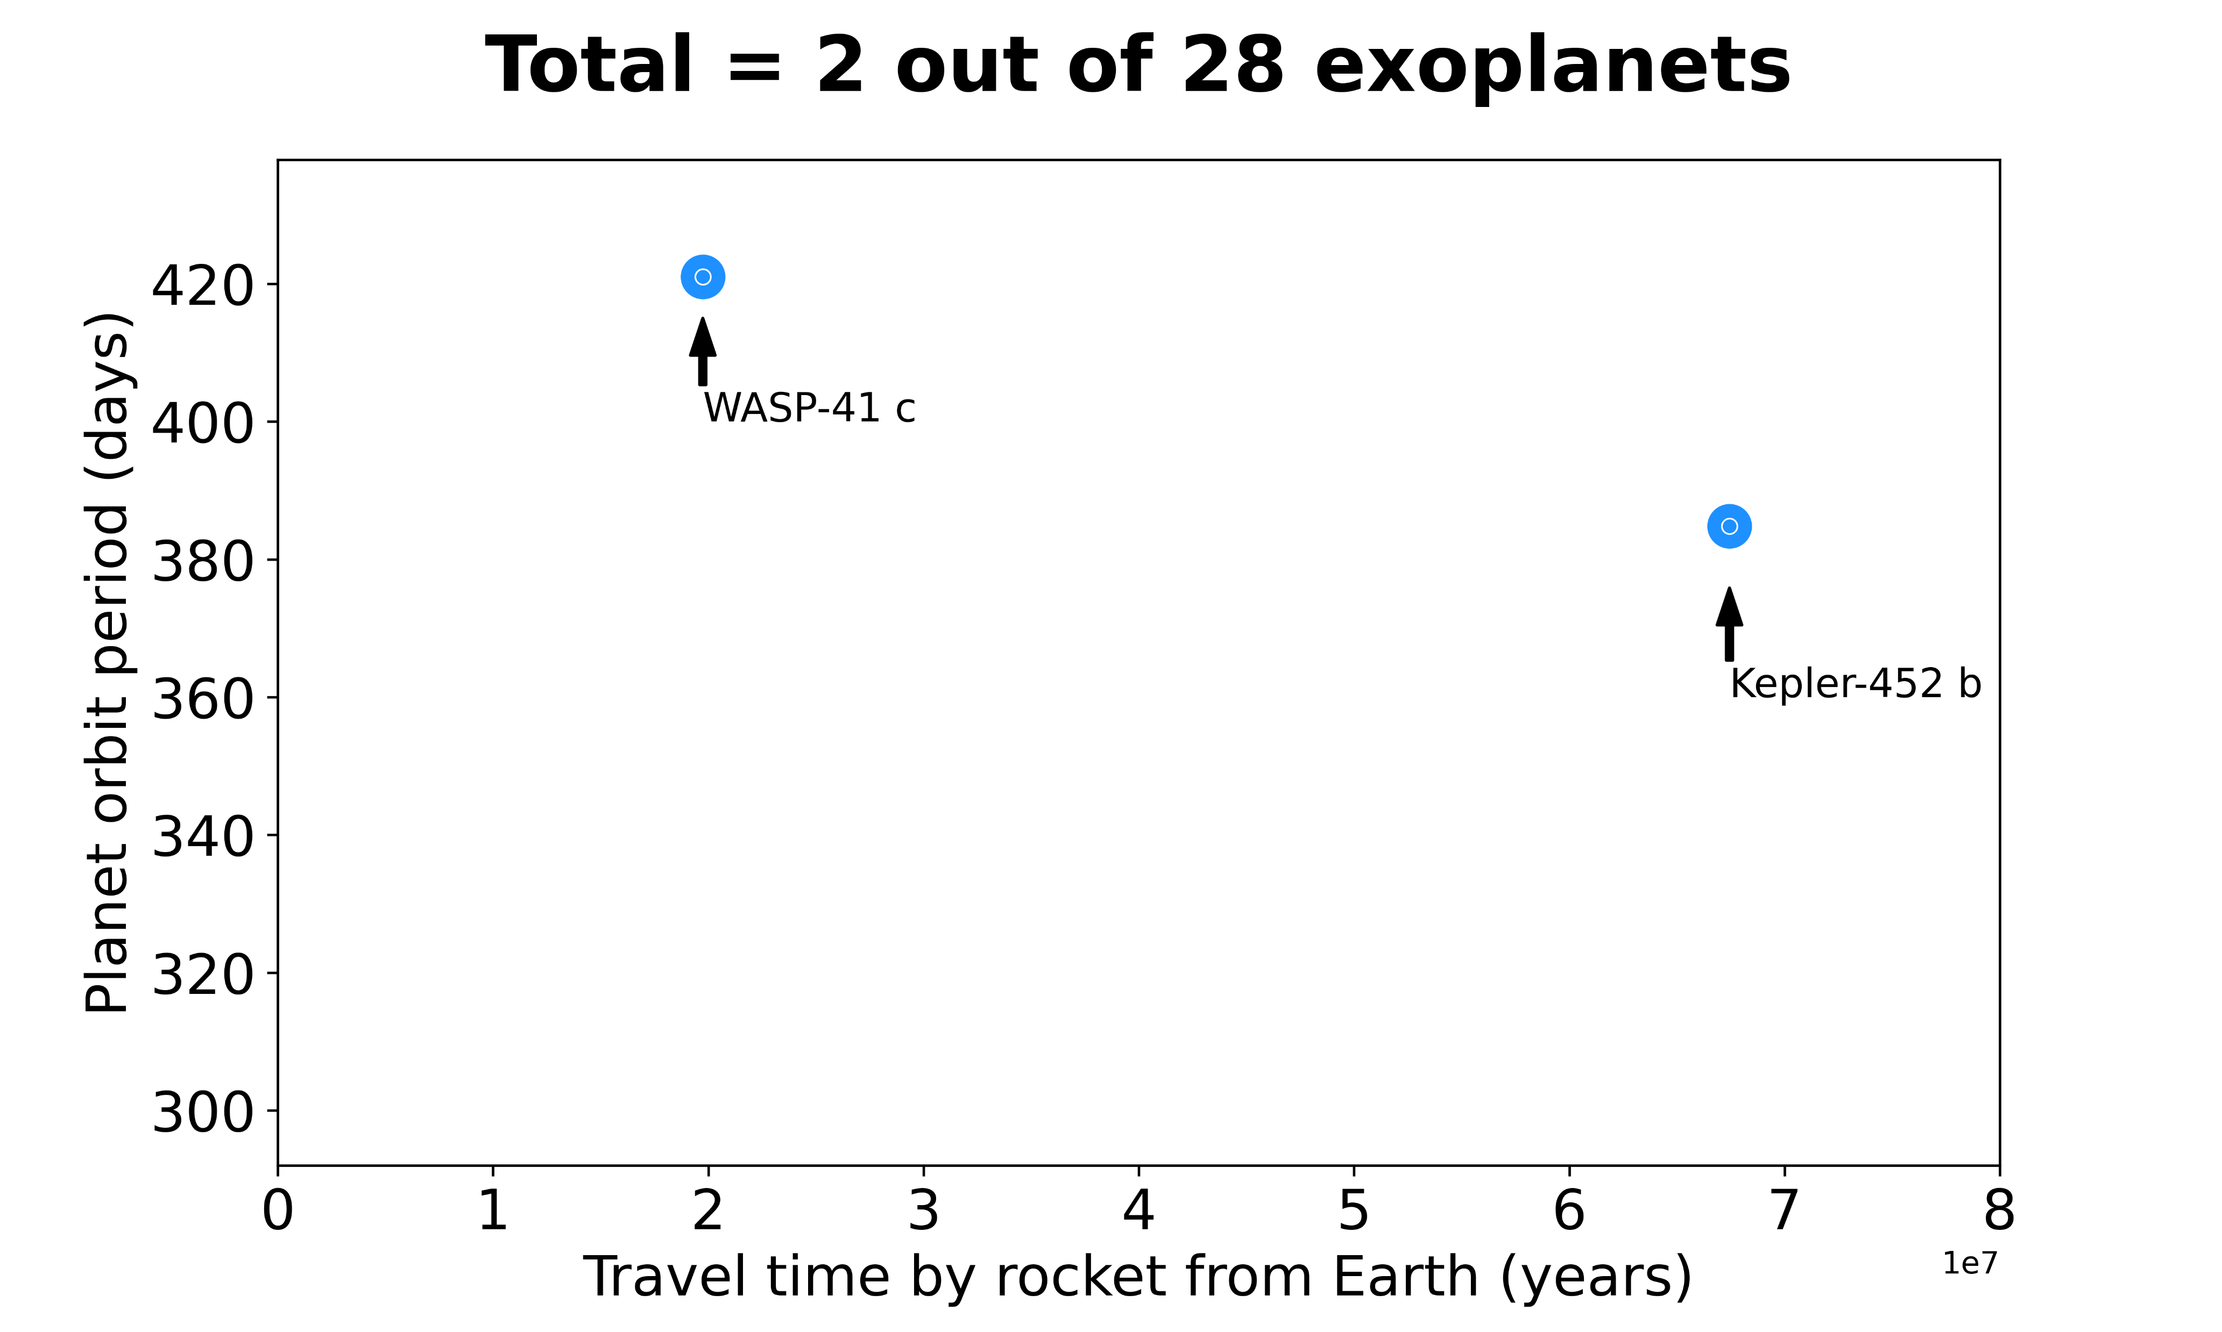
Packing already?
Well, not just yet!

